Slide 1


Welcome to Year 5
Teachers: Miss Roque
Assistants: Mrs Poultney

Slide 2



Time to reflect…
Let’s take a moment to reflect on the unique qualities of your child and our pupils.
Dear God,
Please take our children into your arms as they face the new school year.
Help them to live, love and learn in a caring Christian community.
Teach them the ability to grow and follow your path.
Provide them with the resilience needed to tackle the challenges they may face.
Support them as they learn a range of new skills and let us appreciate their individual talents and successes.
Give us the patience we need to support and love our children.
Above all, thank you for the joy they bring to our daily lives.
Amen.

Slide 3
Our Classroom
Welcome to our classroom!
You are welcome to have a look around, there will be opportunities for any questions at the end.
Displays
Lockers
Water bottles
Reading books
Pencil cases and caddies
Plimsoles (indoor shoes)
Visual timetable

Slide 4
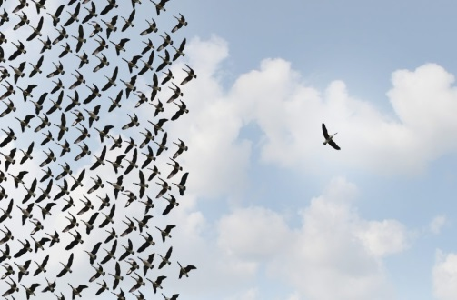
In Year 5…
Our mission statement is at the heart of all we do.
Pupils develop spiritually, emotionally, socially and morally.
Children are encouraged to become more independent and develop resilience.
Individuals are encouraged to take on roles and responsibilities (Vice House Captains, School Councillors)

Slide 5
How can you help your child?
Hearing and supporting them as they read challenging books.
Asking questions when your child is reading to develop their VIPERS (Vocabulary, Inference, Predicting, Explaining, Retrieving and Summarising skills).
Telling the time on an analogue and digital clock.
Supporting their instant recall of times tables and corresponding division facts.
Encouraging children with their organisational skills (homework, named P.E. kit and uniform)
Discussing the school day to find out what your child learnt.

Slide 6

Key dates for the term
Parents consultations – Tuesday 21st November and Thursday 23rd November
Assessment weeks (TBC)
Half term break (Monday 23rd October to Friday 27th October)
End of term (Pupils finish school on Wednesday 20th December at 1.30pm and return Thursday 4th January 2024)
Key dates can all be found on our school website. These are updated regularly

Slide 7
Home learning
English and maths activities are sent home with your child/uploaded to Seesaw or Spelling Shed on a Friday to be submitted in on the following Thursday.
Weekly Spelling lists on Spelling Shed. These will be a combination of key subject vocabulary and spelling patterns linked to the curriculum expectations.
Occasional research tasks related to topics.
Pupils are expected to read independently every night.
At least once a week, parents and carers need to sign that their child has read aloud to them. We will be checking this every Thursday.
Please also encourage your child to practise the times table facts. This can also include multiples, related division facts and factors.
RE homework tasks linked to the topics
Some homework tasks will be submitted online rather than paper copies depending on the task set.

Slide 8

Mathematics in Year 5
National curriculum objectives are set out in the curriculum letter you have received.
Fluency
Maths mastery.
Problem solving.
Arithmetic.
Reasoning.
‘To live, love and learn in a caring Christian community.’

Slide 9
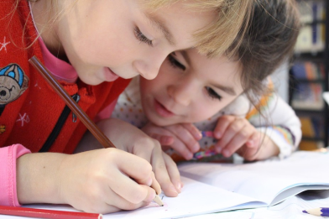
English in Year 5
This year we are using a new scheme which focuses on the purpose of our writing under the four headings: Entertain, Inform, Persuade and Discuss. We will approach these purposes through a range of fiction and non-fiction genres (see curriculum letter).
Grammar is taught during English lessons and spellings are tested weekly on Thursdays.
Weekly guided reading lessons in class.
Pupils are expected to write using cursive script. Cursive handwriting is expected across the curriculum in all lessons.
Emphasis is put on self-editing work using red pens.
‘To live, love and learn in a caring Christian community.’

Slide 10


Assessment
In UKS2, assessment takes a number of forms:
Ongoing assessment by teacher and teaching assistants.
Self-assessment and peer assessment (AFL)
End of topic assessments for all subjects.
Summative assessments (generally before each half term) for English and maths.
Children have target sheets in their books and are aware of what has not yet been completed.
‘To live, love and learn in a caring Christian community.’

Slide 11

PE sessions
This Term:
Wednesday afternoon (Gymnastics and some football)
Friday afternoons (Football)
A named P.E. kit and trainers are needed. When it gets colder, school tracksuits are advised.
‘To live, love and learn in a caring Christian community.’

Slide 12

Intervention
Some children will go out for regular intervention sessions in small groups to support their in class learning, where needed.
-These sessions will focus on reading, writing and maths and will be planned by myself.
-These may be delivered in the mornings or in the afternoons by either Mrs Poultney or Mrs Strachan.
‘To live, love and learn in a caring Christian community.’

Slide 13


Contacting Us
To get in touch with us, email via the school office or by emailing admin@stjosephs207.herts.sch.uk If required, we will respond within three working days.
For any homework queries, you may contact on Seesaw.
‘To live, love and learn in a caring Christian community.’

Slide 14

Any Questions?
‘To live, love and learn in a caring Christian community.’

