Slide 1


Welcome to Year 5
Teachers: Miss Roper (Wed-Fri)
and Mrs Higgs (Mon-Tues)
Miss Roque - Rowan
Assistant: Mrs Poultney

Slide 2



Time to reflect…
Let’s take a moment to reflect on the unique qualities of your child and our pupils.
Dear God,
Please take our children into your arms as they face the new school year.
Help them to live, love and learn in a caring Christian community.
Teach them the ability to grow and follow your path.
Provide them with the resilience needed to tackle the challenges they may face.
Support them as they learn a range of new skills and let us appreciate their individual talents and successes.
Give us the patience we need to support and love our children.
Above all, thank you for the joy they bring to our daily lives.
Amen.

Slide 3
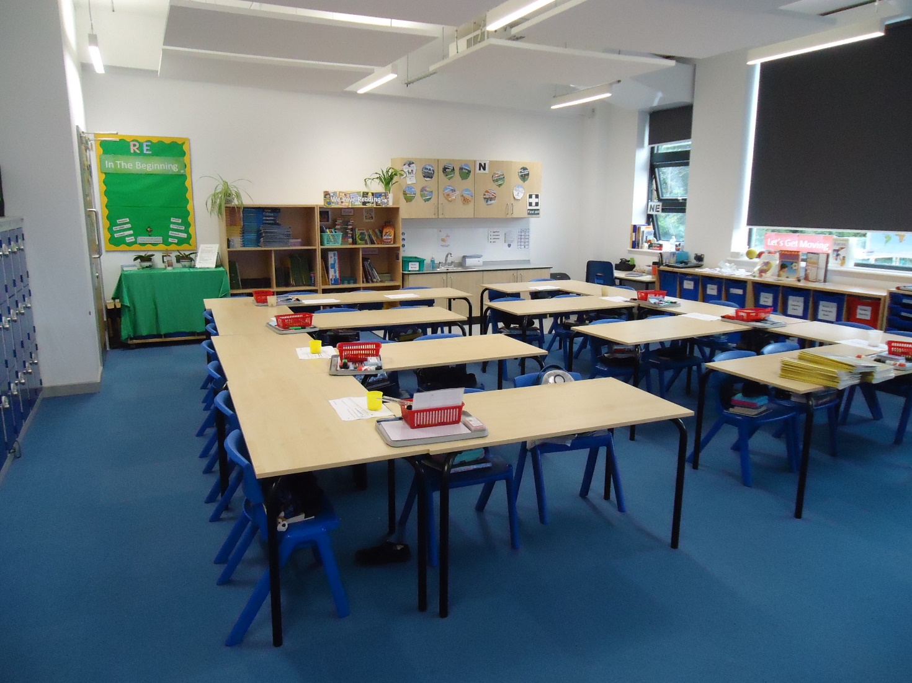

Our Classroom

Slide 4
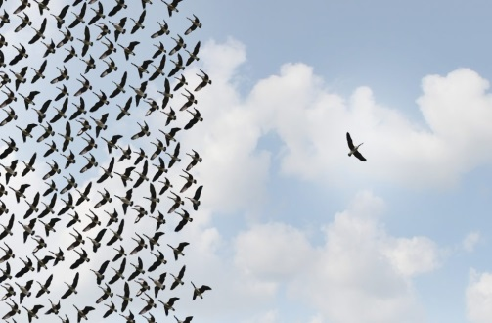
In Year 5…
Our mission statement is at the heart of all we do.
Pupils develop spiritually, emotionally, socially and morally.
Children are encouraged to become more independent and develop resilience.
Individuals are encouraged to take on roles and responsibilities (Vice House Captains, School Councillors)

Slide 5
How can you help your child?
Hearing and supporting them as they read more challenging books.
Asking questions when your child is reading to develop their VIPERS (Vocabulary, Inference, Predicting, Explaining, Retrieving and Summarising skills).
Telling the time on an analogue and digital clock.
Supporting their instant recall of times tables and corresponding division facts.
Encouraging children with their organisational skills (homework completed on time, named P.E. kit and uniform)
Discussing the school day to find out what your child learnt.

Slide 6

Key dates for the term
Parents consultations – Tuesday 21st November and Thursday 23rd November
Assessment weeks (TBC)
Half term break (Monday 23rd October to Friday 27th October)
End of term (Pupils finish school on Wednesday 20th December and return on Thursday 4th January 2024)
Key dates can all be found on our school website. These are updated regularly

Slide 7
Home learning
English and maths activities are sent home with your child/uploaded to Seesaw or Spelling Shed on a Friday to be submitted on the following Thursday.
Weekly Spelling lists on Spelling Shed. These will be a combination of key subject vocabulary and spelling patterns linked to the curriculum expectations.
Occasional research tasks related to topics.
Pupils are expected to read independently every night and at least once a week to a parent. Parents are asked to sign their child’s record book to indicate this has been carried out.
Please also encourage your child to practise the times table facts. This can also include multiples, related division facts and factors.
RE homework tasks linked to the topics
Some homework tasks will need to be submitted online rather than paper copies depending on the task set.

Slide 8

Mathematics in Year 5
Maths is taught in class.
National curriculum objectives are set out in the curriculum letter you have received.
Fluency - (vocabulary)
Maths mastery
Problem solving.
Arithmetic.
Reasoning.
‘To live, love and learn in a caring Christian community.’

Slide 9

English in Year 5
This year we are using a new scheme which focuses on the purpose of our writing under the four headings: Entertain, Inform, Persuade and Discuss. We will approach these purposes through and range of fiction and non-fiction genres (see curriculum letter).
Grammar is taught during English lessons
Spellings are tested weekly on Thursdays.
Guided Reading takes place each week in class.
Pupils are expected to write using cursive script in all lessons.
Emphasis is put on self-editing work with a red pen.
‘To live, love and learn in a caring Christian community.’

Slide 10


Assessment
In UKS2, assessment takes several forms:
Ongoing assessment by teacher and teaching assistants.
Self-assessment and peer assessment (AFL)
End of topic assessments for all subjects.
Summative assessments (generally before each half term) for English and maths.
Children have target sheets in their books and are aware of what has not yet been completed.
‘To live, love and learn in a caring Christian community.’

Slide 11


Contacting Us
To get in touch with us, email via the school office or by emailing admin@stjosephs207.herts.sch.uk If required, we will respond within three working days.
Please note that Seesaw is only used for homework related information.
‘To live, love and learn in a caring Christian community.’

Slide 12

Any Questions?
‘To live, love and learn in a caring Christian community.’

