Slide 1


Welcome to
Year Six
Teachers: Mr Carrington and Miss Curran
Teaching Assistants: Mrs Strachan and Mrs Tracy

Slide 2

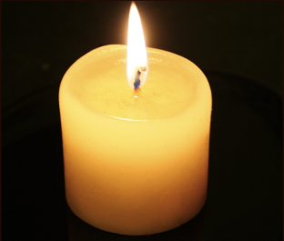

Time to reflect…
Let's take a moment to reflect on the unique qualities of your child and our pupils.
Dear God,
Please take our children into your arms as they face the new school year.
Help them to live, love and learn in a caring Christian community.
Teach them the ability to grow and follow your path.
Provide them with the resilience needed to tackle the challenges they may face.
Support them as they learn a range of new skills and let us appreciate their individual talents and successes.
Give us the patience we need to support and love our children.
Above all, thank you for the joy they bring to our daily lives.
Amen.

Slide 3
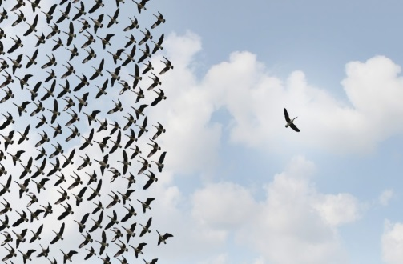
In Year Six …
Our mission statement is at the heart of all we do.
Pupils develop spiritually, emotionally, socially and morally.
Children are encouraged to become more independent and develop resilience.
Individuals are encouraged to take on roles and responsibilities (Chaplaincy Team, House Captains, Sports Captains)

Slide 4

How can you help your child?
Hearing and supporting them as they read challenging books.
Asking questions when your child is reading to develop their VIPERS (Vocabulary, Inference, Predicting, Explaining, Retrieving and Summarising skills).
Telling the time on an analogue and digital clock.
‘To live, love and learn in a caring Christian community.’

Slide 5
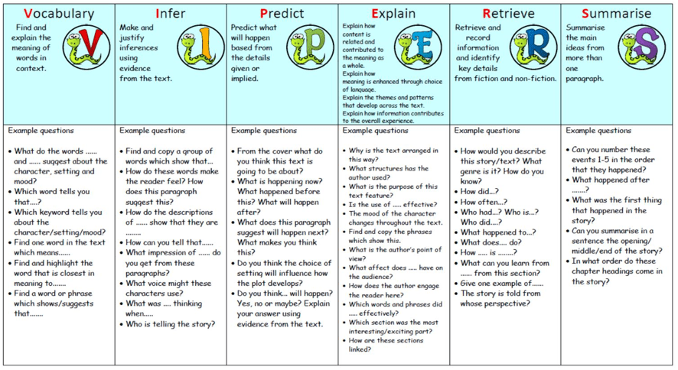

Slide 6
How can you help your child?
Supporting their instant recall of times tables and corresponding division facts.
Encouraging children with their organisational skills (homework, named P.E. kit and uniform).
Discussing the school day to find out what your child learnt.
‘To live, love and learn in a caring Christian community.’

Slide 7

Key dates for the term
Parents consultations – provisional dates of Tuesday 21st November and Thursday 23rd November.
Assessment weeks (TBC)
Half term break (Pupils finish school on Friday 20th October and return on Monday 30th October.
End of term (Pupils finish school on Wednesday 20th December and return on Thursday 4th January)
Key dates can all be found on our school website. These are updated regularly

Slide 8
Home learning
English and maths activities are set online on a Friday to be submitted by the following Friday.
Weekly Spelling lists on Spelling Shed. These will be a combination of key subject vocabulary and spelling patterns linked to the curriculum expectations.
Occasional research tasks related to topics.
‘To live, love and learn in a caring Christian community.’

Slide 9

Home learning
Pupils are expected to read every night.
One piece of R.E. homework per term.
We may ask for some pieces of homework to be submitted on Seesaw.
‘To live, love and learn in a caring Christian community.’

Slide 10

Mathematics in Year Six
Maths is taught in class.
National curriculum objectives are set out in the curriculum letter you have received.
Fluency
Maths mastery.
Problem solving.
Arithmetic.
Reasoning.
‘To live, love and learn in a caring Christian community.’

Slide 11
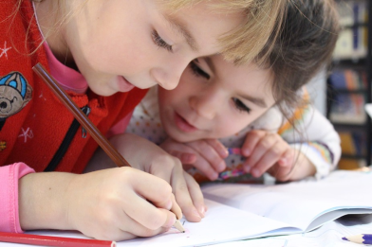
English in Year Six
English is taught in class.
Grammar and spelling are covered throughout these lessons.
Weekly guided reading lessons in class.
Pupils will focus on a range of fiction and non-fiction genres throughout their English topics (see curriculum letter).
Pupils are expected to write using cursive script. Cursive handwriting is expected across the curriculum in all lessons.
Emphasis is put on self-editing work.
‘To live, love and learn in a caring Christian community.’

Slide 12
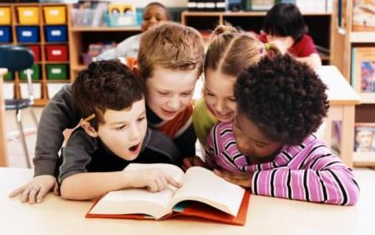

Assessment
In UKS2, assessment takes a number of forms:
Ongoing assessment by teacher and teaching assistants.
Self assessment and peer assessment (AFL)
End of topic assessments for all subjects.
Summative assessments (generally before each half term) for English and maths.
These will be sent once marked and targets have been set. This is so you can see how your child has performed, and what they might need help with.
Children are aware of their own targets (TAFs) and how to improve their work through feedback.
‘To live, love and learn in a caring Christian community.’

Slide 13

PGL
In Year Six, the children have the opportunity to take part in a residential trip to PGL in Windmill Hill, Sussex.
This year, our trip will take place on Friday 7th June until Monday 10th June 2024.
We will be hosting a meeting on Monday 2nd October 2023 to offer you more information about the trip and answer any questions you may have.

Slide 14


Contacting Us
To get in touch with us, email via the school office or by emailing admin@stjosephs207.herts.sch.uk If required, we will respond within three working days.
‘To live, love and learn in a caring Christian community.’

Slide 15

Any Questions?
‘To live, love and learn in a caring Christian community.’

