Slide 1

Welcome to
Year 3
Hazel Class: Mrs T Duhig
(TA is Mrs S Duggan)
Maple Class: Mrs C Saunders
(TA is Mrs M Dalzell)

Slide 2
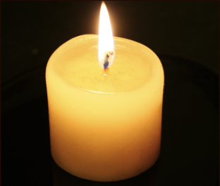

Time To Reflect.
Dear God,
At the beginning of this new school year, we implore your mercy: bless the children, teachers, and staff, that together we may grow in faith, hope, and love as we learn from you and each other how to follow your Son, Jesus.
Amen.

Slide 3
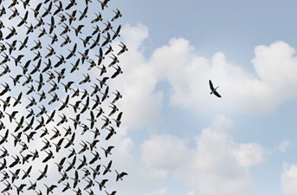

Our Mission Statement.
Our mission statement is at the heart of all we do.
It is referred to every day so that the children understand how they can use it to guide them, both at school and at home.
Our pupils develop spiritually, emotionally, socially and morally.
Children are encouraged to become more independent and to develop a resilient approach to everyday challenges with a positive growth mind set.
Children will have greater responsibilities for their own learning and for their contribution to school life.

Slide 4
Daily Routine.
8.45am – 9.00am Arrival time. If you arrive after this time, please take your child to the office to sign them in.
9.00am – Registration, lunch choices then lessons begin.
10.30am – 10.45am Break.
11.45am – 12.45pm Lunch.
3.25pm – Collection time. If you arrive late, your child will be taken to the office for collection from there. Please ensure you let your child’s teacher know if there are any changes to end of day arrangements.

Slide 5
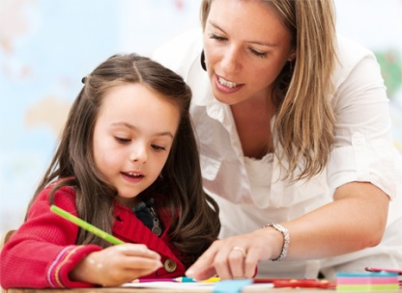

How you can help your child.
Hearing and supporting them as they read challenging books.
Asking questions when your child is reading. Understanding the text (comprehension) is as important as being able to decode the words.
Encouraging a love of reading and reading for pleasure.
Telling the time on an analogue and digital clock.

Slide 6
How you can help your child.
Supporting their recall of times tables and corresponding division facts (Starting point- 2s, 5s and 10s. Year 3- 3s, 4s and 8s).
Encourage your child to become generally more independent, responsible and organised. For example: tie their own neck ties, tie their own shoe laces, change their own clothes for PE.

Slide 7

Homework.
Homework will be uploaded on Seesaw every Friday and a photo of your child’s work should be uploaded by the following Thursday via your child’s Seesaw profile.
Each week the homework will be read and acknowledged with a ‘like’ and, sometimes, a feedback comment given.
The children’s homework will alternate between Maths, English and a Foundation Subject.
The children are expected to practise their reading each evening, as well as their times tables and spellings.

Slide 8


Maths.
Expectation examples:
Develop a secure understanding of place value (hundreds, tens and ones).
Become fluent with a range of mathematical strategies and methods for +,x,- and ÷.
Develop mastery within mathematics.
Tell and write the time from an analogue clock and digital clock.
Recognise angles and turns.
Become fluent with multiplication and division facts for the 2,5,10,3,4 and 8 times tables by the end of Year 3.
‘To live, love and learn in a caring Christian community.’

Slide 9

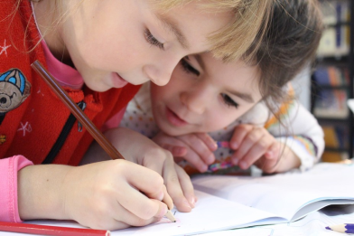
Writing.
Pupils receive a daily English lesson consisting of work linked to a unit, handwriting and guided reading.
Grammar and punctuation skills are covered during all of these lessons.
Pupils will focus on a range of fiction and non-fiction genres throughout their English topics.
‘To live, love and learn in a caring Christian community.’

Slide 10
Writing.
Pupils are expected to write using cursive script.
Once they consistently and accurately write in this style, they will obtain their pen licence and may then use a blue Berol pen when writing.
‘To live, love and learn in a caring Christian community.’

Slide 11

Reading.
Phonics will be incorporated into daily teaching where opportunities arise. Some children will also receive phonics catch-up sessions in small groups.
Children will take home a reading book (until they become a free reader) on Fridays and this will need to be returned the following Wednesday. Please sign or record comments in your child’s reading record when you read with them at home. We will use our own record sheets in school.
Your child must re-read their book in order to develop their decoding, fluency and comprehension skills. Therefore, your child can read their books several times. This is a healthy reading habit to encourage. We do this as adults, re-read our favourite books, and each read usually reveals a new layer of understanding and enjoyment!
‘To live, love and learn in a caring Christian community.’

Slide 12


“That’s not how they taught it in my day…”
Many mathematical and reading strategies, as well as curriculum expectations, have been changed and modified over the years.
If you ever have any questions about the teaching methods used, please ask! We are here to help you too.
‘To live, love and learn in a caring Christian community.’

Slide 13

Extra! Extra!
PE lessons are held twice weekly. Please ensure that every piece of your child’s kit is fully labelled.
Please ensure your child has a school approved PE kit in order to participate fully in the lessons. This will be sent home each half term for washing. Full details of our school PE kit is available on the school website.
Reading Books, Reading Records and Times Tables Cards must be in your child’s school bag every day. These are needed for reading/assessment with an adult.
All children need a pair of named plimsolls for indoor use which will remain in school.
Please label all of your child’s school belongings, including their outdoor wear, to avoid confusion and upset.
‘To live, love and learn in a caring Christian community.’

Slide 14
Extra! Extra!
If your child wishes to have a keyring on their book bag, please limit this to one small keyring only.
If your child wears wellies to school on a rainy day, they must have their outdoor shoes to change into on arrival so that the wellies can be taken home.
Headbands, clips and hairbands must be small and in line with our school colour.
Please be mindful that space in our classrooms is rather limited, especially when preparing for the winter uniform (coats, hats, gloves etc).
‘To live, love and learn in a caring Christian community.’

Slide 15

Any Questions?
‘To live, love and learn in a caring Christian community.’

