Slide 1
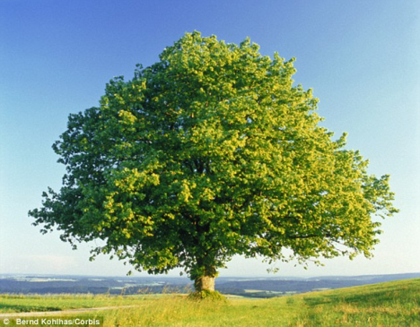
The mission of schools is to develop a sense of truth, of what is good and beautiful. And this occurs through a rich path made up of many ingredients. “True education enables us to love life and opens us to the fullness of life.”
Pope Francis
Welcome to Year 4
Teachers: Mrs Browne & Mrs Canny
Teaching Assistant: Mrs Nolan and Mrs Michael

Slide 2

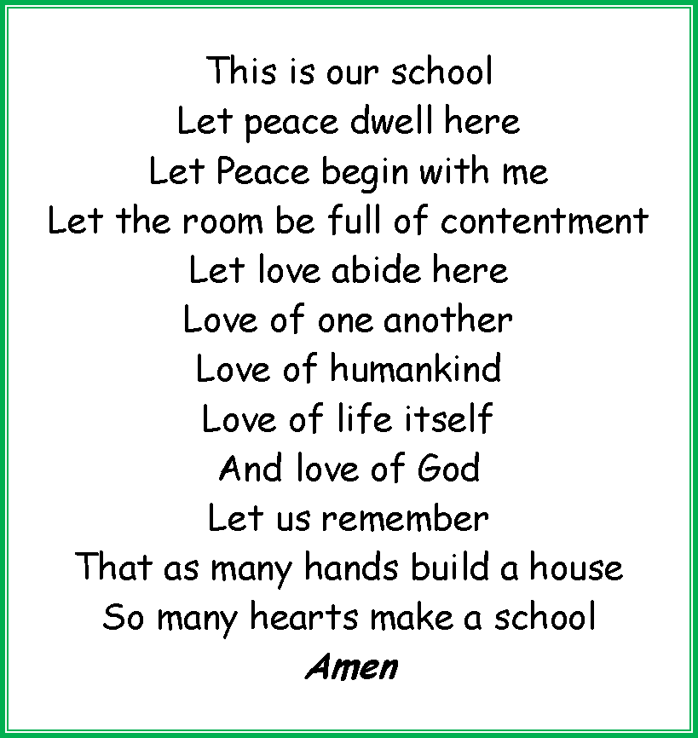
Prayer

Slide 3
In Year 4
Our mission statement is at the heart of all we do.
Our pupils develop spiritually, emotionally, socially and morally.
Children are encouraged to become more independent and to develop a resilient approach to everyday challenges with a growth mind set.
Children will have greater responsibilities for their own learning and for their contribution to school life.
We stay safe by washing our hands before and after eating. We use catch it – kill it – bin it to trap germs on tissues. We also have staggered break and lunchtimes.

Slide 4
Important dates for this term
Half term break is from 23rd^{th} -27th October
Parent consultations - Tuesday 21st November and Thursday 23rd November
End of term - Wed 20th Dec at 1:30pm
These dates should be on the school web site.

Slide 5
Weekly Lessons: P. E.
This Term:
P.E. Pine - Monday (swimming) and Thursday/Friday (outdoor games)
Oak – Monday and Thursday
A named P.E. kit and trainers are needed. When it gets colder, school tracksuits are advised.

Slide 6
How can you help your child?
Give support as your child reads more challenging books. Ask questions about what they have read e.g. can they recall the main points, predict story outcomes and infer from clues in the text (see information letter for more information).
Encourage reading for pleasure.
Learn to tell the time on analogue and digital clocks.
Support your child as they develop a quick recall of times table facts and related division facts.
There is an official test this summer for times tables
in Year 4.
Encourage your child to become more independent, responsible and organised.

Slide 7
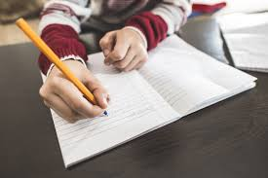
Homework
English, Maths, R.E. and other topic based activities are on a rolling programme through the year.
Pupils are expected to read every night - ideally to an adult. Regular reading leads to better results.
Try to find a quiet and convenient time for both you and your child to do their homework.
Multiplication tables – Your child has a card that they work though systematically at their own pace. They are tested on this in school.
Spelling Shed activities will accompany the weekly spelling rules and word lists.
Please check Seesaw regularly for homework and any updates you need to be aware of.

Slide 8
Mathematics in LKS2
Expectations are that pupils will:
develop a secure understanding of place value.
become fluent with a range of mathematical strategies and methods for +,x,- and ÷
develop mastery skills within mathematics.
tell and write the time from an analogue clock or digital clock. Know the time from a 12-hour and a 24-hour clock.
become fluent with multiplication and related division facts for all times tables by the end of Year 4. (The government has introduced an official electronic test for Year 4 children, for the Summer Term and we will share details of this as and when we receive them).

Slide 9
Writing in LKS2
As well as English lessons, grammar is also taught discretely.
Pupils focus on a wide range of fiction and non-fiction genres.
Pupils are expected to write using cursive script. Once they consistently write in this style, they can achieve their pen licence and write in a blue berol pen.

Slide 10
Reading in LKS2
Phonics will be incorporated into daily teaching where opportunities arise. Some children will also receive phonics catch-up sessions in small groups.
Child read everyday as part of their lessons and will also have other opportunities to read e.g. during guided reading sessions.
Currently, pupils are encouraged to take a reading book home once a week on a FRIDAY. This needs to be returned by WEDNESDAY so that comments can be read and books changed if necessary. This is so that we can hear children read in school too.
There is a book list available as a suitable guide called, ‘Recommended reads for Year 3 and 4 pupils,’ to help guide choices of home novels.

Slide 11
“That’s not how they taught it in my day”
Please be aware that many mathematical and reading strategies have changed over recent years and the curriculum expectations have significantly expanded too.
If ever you have any questions about the teaching methods used, please ask!

Slide 12
We will send home a copy of:
the Year 4 recommended reading list
our cursive writing handwriting formation sheet
THESE WILL ALSO BE MADE AVAILABLE ON THE SCHOOL WEBSITE

Slide 13

Any Further Questions?
Please email admin@stjosephs207.herts.sch.uk
FAO Mrs Browne - Pine
FAO Mrs Canny- Oak

