Slide 1
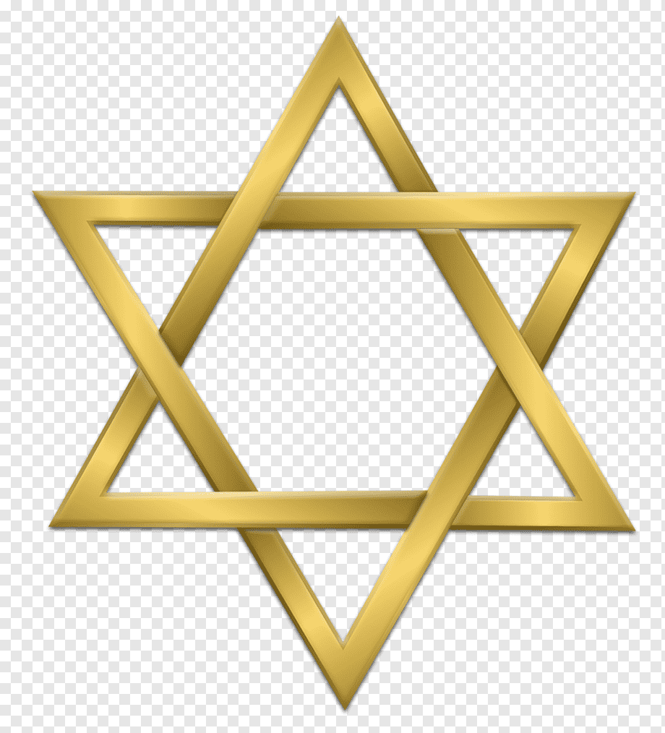
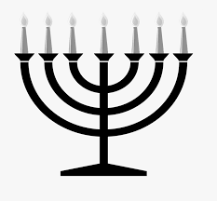
LKS2 R.E.
JUDAISM

Slide 2
JUDAISM
During this unit of work, you will learn about:
The Jewish customs and place of worship
The day of rest (The Shabbat)
Significant days in the Jewish calendar
The Passover

Slide 3
JUDAISM
What are the important beliefs in Judaism?
Jewish people believe in God. They believe in the Old Testament, but not the New Testament.
They believe that, through Moses, God led the people of Israel out of slavery in Egypt.
Jewish people believe that the Ten Commandments are their rules from God.

Slide 4
L1
L/O: To understand that the Synagogue is the Jewish place of worship
Starter activity
During your time at St. Joseph’s you would have learnt a little about the Jewish faith in previous learning.
What can you remember?
Can you add two more facts to mine?
People who follow Judaism are called Jews.
-
-

Slide 5
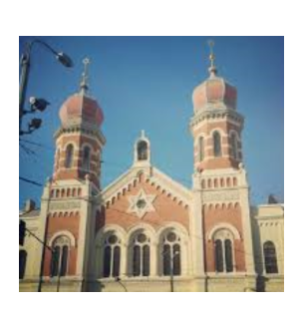
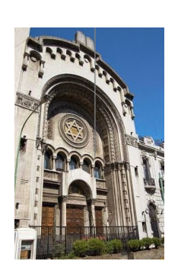
L1
L/O: To understand that the Synagogue is the Jewish place of worship
The Synagogue
This is the place where Jewish people go to worship. It is a beautiful building with unique features. Take a look at these pictures of two Synagogues.
Can you notice any common features?

Slide 6
L1
L/O: To understand that the Synagogue is the Jewish place of worship
You may have noticed the star that sits on the front of the Synagogue.
This is called the Star of David.
It is a common symbol associated with Judaism and the Jewish people.
It represents the connection between the three main Jewish points of faith:
The Holy One (God)
The Holy Book (The Torah)
The Holy Place (Israel)

Slide 7
L1
L/O: To understand that the Synagogue is the Jewish place of worship
The Shabbat
Shabbat means ‘Sabbath'. It is the Jewish day of rest, where they remember that God rested on the seventh day after creating the world. This happens every Saturday.
Jewish people go to the Synagogue on Shabbat because they gather as a community to worship and celebrate the seventh day of God's Creation.

Slide 8
L1
L/O: To understand that the Synagogue is the Jewish place of worship
Activities – choose one of the following tasks
Task 1
Draw the Star of David and use the points of the triangles to write some facts about it.
Task 2
Sketch a drawing of a Synagogue and label some of its main features.
https://www.bbc.co.uk/bitesize/clips/z834wmn
Task 3
Write a paragraph describing the Shabbat and why it is important to the Jewish people.

Slide 9

L1
L/O: To understand that the Synagogue is the Jewish place of worship
AfL
Write down one new thing that you have learnt today.

Slide 10

L2
L/O: To learn about important days in the Jewish calendar
Learning recap
What is a Synagogue and why is it important?
What is the Jewish day of rest called?

Slide 11

L2
L/O: To learn about important days in the Jewish calendar
Today we will be learning about two of the most important days in the Jewish faith:
Rosh Hashanah
Yom Kippur
Have you heard of these days?
What do you think they may mean?

Slide 12

L2
L/O: To learn about important days in the Jewish calendar
Rosh Hashanah
This is the Jewish New Year, a holiday that is observed with festive meals.
It is also a day that is spent in quiet prayer where Jews think about God and thank him for his creation. This will often be celebrated in the Synagogue.

Slide 13
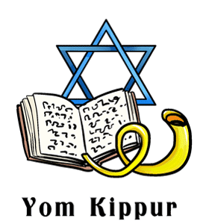
L2
L/O: To learn about important days in the Jewish calendar
Yom Kippur
Yom Kippur, also known as the Day of Atonement, is the holiest day of the year in Judaism. Its central themes are atonement and repentance. Jews traditionally observe this holy day with a day-long fast and intensive prayer, often spending most of the day in synagogue services asking God for forgiveness.

Slide 14
L2
L/O: To learn about important days in the Jewish calendar
Individual research
Use the web links below to make some notes about the celebration of either of these two days. If you’re feeling adventurous you may decide to learn more about both!
Rosh Hashanah
https://www.ducksters.com/holidays/rosh_hashanah.php
https://www.bbc.co.uk/newsround/29363650
Yom Kippur
https://www.bbc.co.uk/bitesize/topics/znwhfg8/articles/z4vvjhv
https://www.bbc.co.uk/newsround/41337138

Slide 15
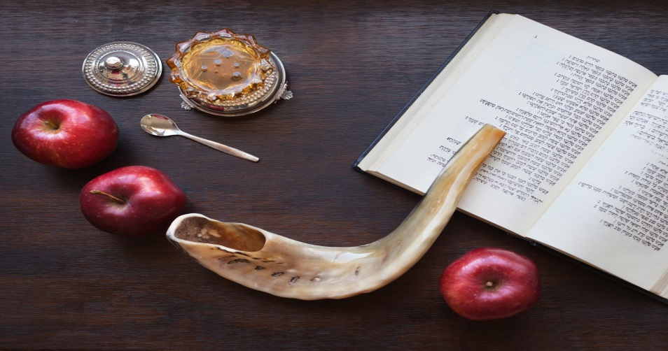
L2
L/O: To learn about important days in the Jewish calendar
Main activity
Using the information you have gathered from your research, I would like you to choose one of these days and show me what you have learnt. You can do this using whichever method you would like. This could be as:
A fact file
A poster
A piece of writing
A labelled drawing

Slide 16
L2
L/O: To learn about important days in the Jewish calendar
AfL
Have you enjoyed the lesson today?
Write down the most interesting thing you have learnt today?

Slide 17
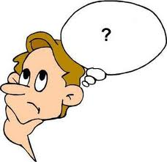
L3
L/O: To understand the significance of the Passover
Learning recap
What do Rosh Hashanah and Yom Kippur celebrate?

Slide 18
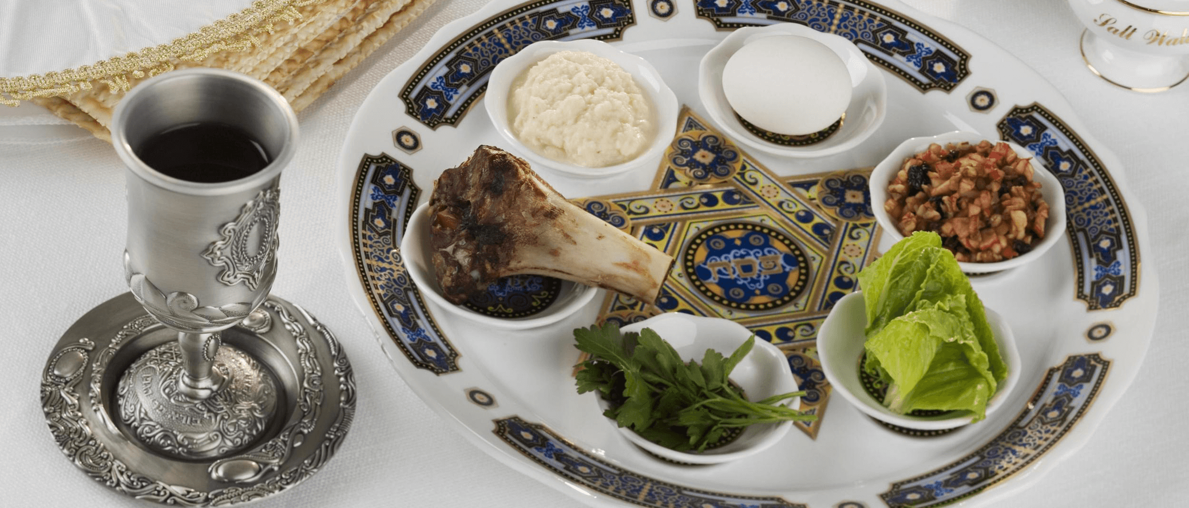
L3
L/O: To understand the significance of the Passover
Have you heard of the Passover or the Passover Meal?

Slide 19
L3
L/O: To understand the significance of the Passover
The Passover is very special to the Jewish people because it remembers how the people of Israel were led out of slavery in Egypt by Moses.
The link below will help you to understand more about this occasion and why it is so significant in the Jewish faith:
https://www.bbc.co.uk/newsround/39565685

Slide 20
L3
L/O: To understand the significance of the Passover
What is the story?
Over 3,000 years ago, a group of Jewish people called the Israelites were being kept in slavery by the ruler of Egypt called Pharaoh.
A man called Moses went to see Pharaoh many times to ask him to let them go, but Pharaoh refused.
Moses told him that if he did not release them, God would make terrible things called plagues happen to the Egyptians.
But Pharaoh did not listen, so the plagues came.
These ten plagues included the River Nile turning to blood, frogs covering the land, insect infestations, animals dying, Egyptians getting skin diseases, the sun stopping shining and the first-born child in Egyptian families being killed by an angel.
God is said to have told Moses to tell the Israelites to paint lamb's blood on their doorposts. This way, the angel would know that Jewish people lived there. It would pass over that house and not kill the first-born child.
This is where the name Passover comes from.

Slide 21
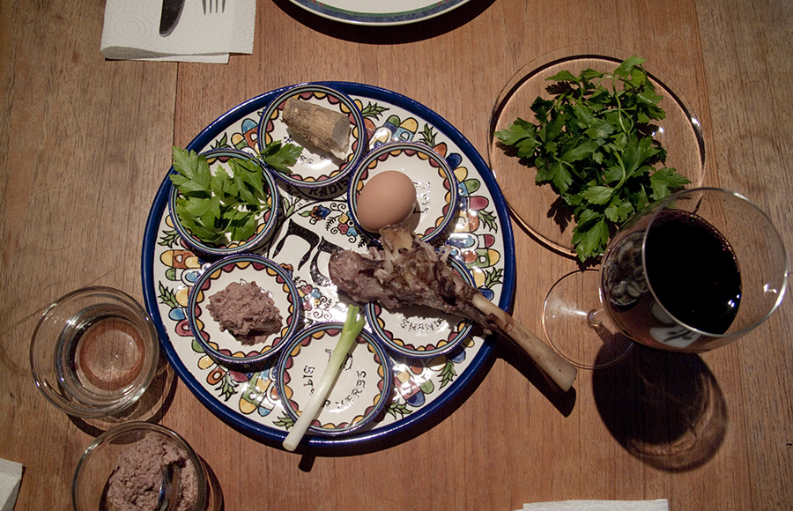
L3
L/O: To understand the significance of the Passover
The Passover Meal
At the beginning of Passover in the evening, family and friends will get together for a meal and a special service called a Seder.
There is a special Seder plate which has certain things on it:

Slide 22
L3
L/O: To understand the significance of the Passover
Each item on a Seder plate has a particular significance in remembering the pain and suffering of the Israelites before they were led to freedom. Find out more here:
https://www.bbc.co.uk/bitesize/topics/znwhfg8/articles/zn22382
https://www.myjewishlearning.com/article/the-seder-plate/

Slide 23
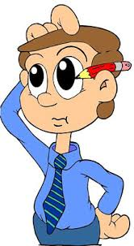
L3
L/O: To understand the significance of the Passover
Activity – Choose your challenge
Challenge 1
Using words and pictures show your understanding of the Passover story.
Challenge 2
Draw and label a Seder Plate. Include the reasons behind each item on the plate.

Slide 24
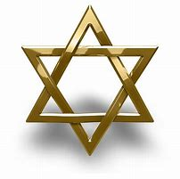
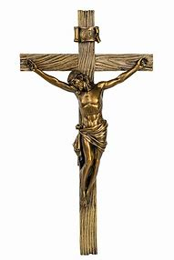
L3
L/O: To understand the significance of the Passover
AfL
Write down one thing that is similar and one thing that is different between Judaism and Christianity.

