Slide 1
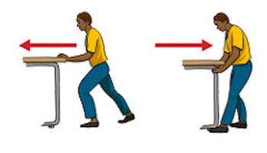
Forces

Slide 2
L.O-To observe and identify forces.
Over our next two science topics, we will be exploring ‘push’ and ‘pull’ forces.
This learning has been adapted to make the activities accessible at home…
Starter activity- Using the link above, have a go at watching the video.
Then, have a go at explaining what a force is to one person in your household.
https://www.bbc.co.uk/bitesize/topics/zvpp34j/articles/zywcrdm

Slide 3
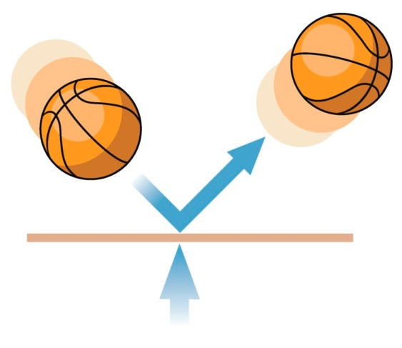
L.O-To observe and identify forces.
What is a force?
A force is always a push, a pull or a twist.
https://www.bbc.co.uk/bitesize/topics/zn77hyc/articles/zptckqt
Practical activity- After you have watched the video showing example forces, go around your house and find objects you have to push, pull or twist in order for them to work (turn to the next slide for a further explanation). The video should give you some examples…

Slide 4
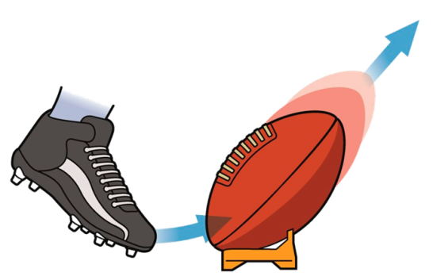
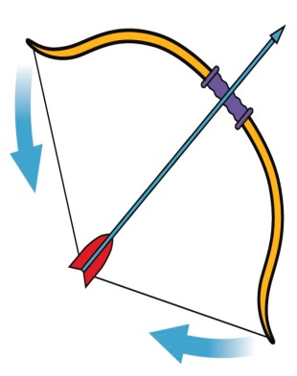
L.O-To observe and identify forces.
Lesson activity
Year 3’s main activity
Get an A4 piece of paper, a ruler and a pencil.
Split your paper into 3 sections as shown below and fill in your own examples. Each column has an example to help you…
Examples of push forces
Push a swing
Examples of pull forces
Pulling a door shut
Examples of twist forces
Twisting a bottle lid off
Extension- Explain what a force is using your own words.

Slide 5

L.O-To observe and identify forces.
Success criteria- Year 3’s
-Remember to think carefully about the type of forces you are observing and record them in the correct columns.
Have a go at the extension task and explain what a force is using full sentences. Think about how you could back your explanation up with your findings.
.

Slide 6
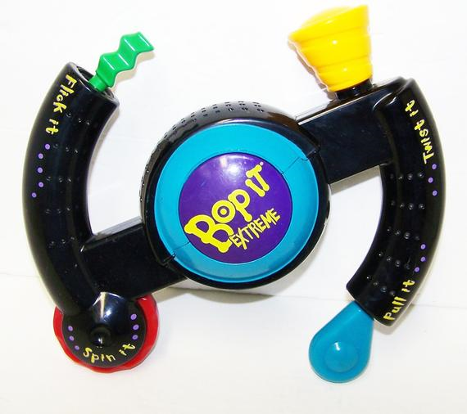
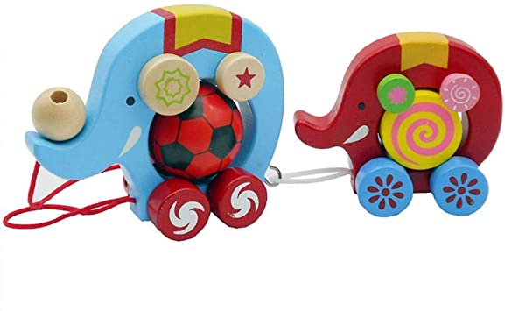
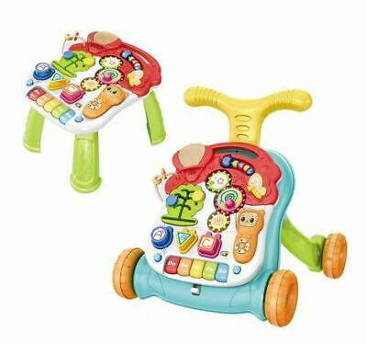
L.O-To observe and identify forces.
Lesson activity
Year 4’s main activity
Have a go at designing a toy that requires a push force, a pull force and a twist force in order to work. Here are some examples to help you.
Extension- Have a go at labelling the forces required in order to make your toy work. Use arrows to show the direction of the forces. Then explain how your toy works using your own words.
.

Slide 7

L.O-To observe and identify forces.
Success criteria-Year 4’s
-Draw your toy on A4 paper.
-Label the forces clearly and think about the direction of the forces.
-Explain how your toy works using full sentences.
.

Slide 8
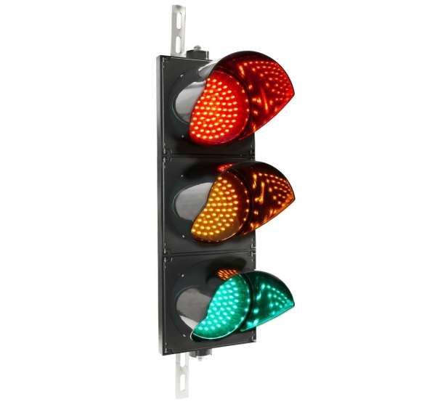
L.O-To observe and identify forces.
AFL
Have a go at telling somebody in your home what a force is.
.

