Slide 1

Teeth and eating

Slide 2
L.O-To understand what forms a balanced diet and begin to explore parts of the digestive system..
Over our next two science topics, we will be exploring the function of teeth and the concept of healthy eating. This learning has been adapted to make the activities accessible at home…
https://www.bbc.co.uk/bitesize/topics/z27kng8/articles/z2rxb82
Starter activity- Using the link above, have a go at watching the video.
Then, have a go at explaining what happens to food when it reaches our mouths.

Slide 3
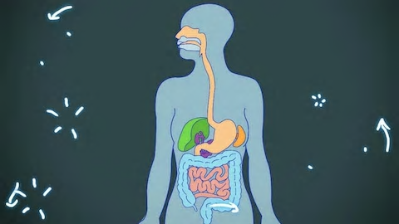
L.O-To understand what forms a balanced diet and begin to explore parts of the digestive system..
https://www.bbc.co.uk/bitesize/topics/z27kng8/articles/z9wk7p3
Practical activity- After you have watched the video which explains why we have a digestive system, go and explain its purpose to somebody in your household.

Slide 4
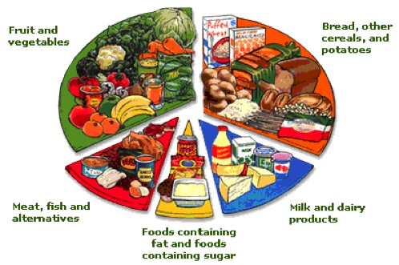
L.O-To understand what forms a balanced diet and begin to explore parts of the digestive system.
In order to keep our bodies healthy, we need to make sure we have access to a variety of food types.
Have a look at the picture below to see what food types are available and have a look at how they are grouped together.

Slide 5
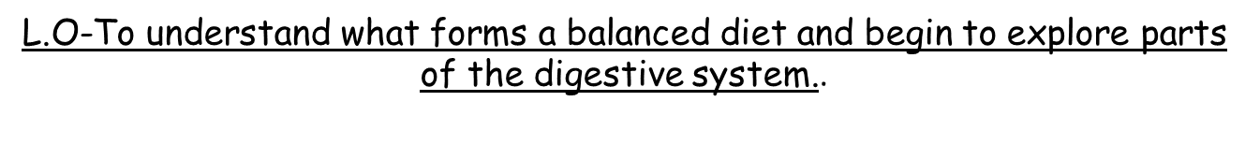
Lesson activity
Year 3’s main activity
Get an A4 piece of paper and draw three circles on it. Then write breakfast, lunch and dinner under the three separate plates.
Have a go at designing a meal for each plate but have a good go at including a variety of foods using the picture from the previous slide.
Breakfast Lunch Dinner
Extension-Write a sentence under each plate to explain which groups the food choices come from using the picture on the previous slide.

Slide 6
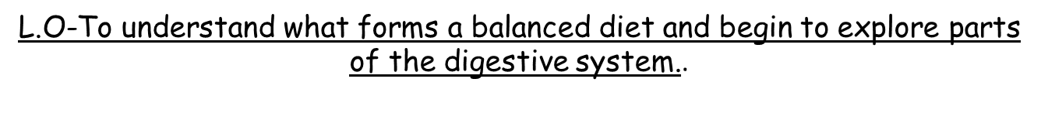

Success criteria- Year 3’s
-Make sure you include a variety of foods in order to design balanced meals.
-Remember it is ok to include some sugary and fatty foods but make sure they are balanced with healthier choices too!
-Have fun designing your meals!
.

Slide 7
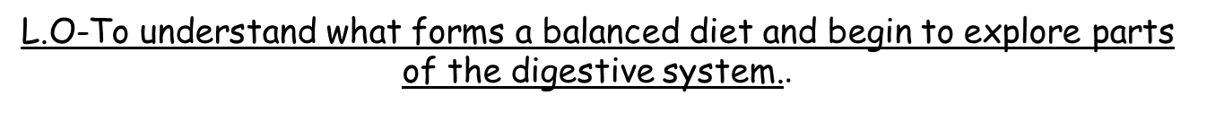
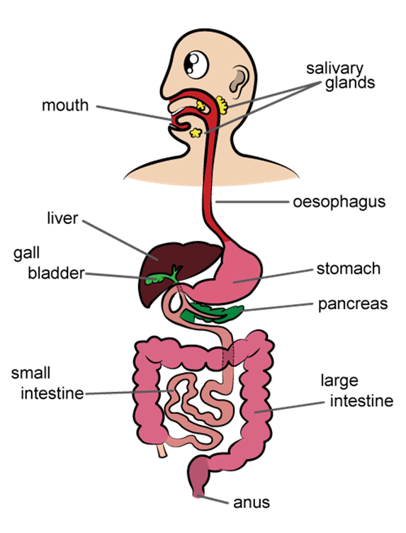
Lesson activity
Year 4’s main activity
Have a look at the diagram showing parts of the digestive system.
Choose one part of the system and use the internet to find out about it including its function.
Extension- Research one other part of the digestive system.
.

Slide 8

Success criteria-Year 4’s
-Use this website to find out about your digestive system part…
https://www.bbc.co.uk/bitesize/articles/zvk4f82
-Remember to explain the purpose and role of your chosen part.
-If you finish, have a go at finding out about a different part of the digestive system.
.

Slide 9
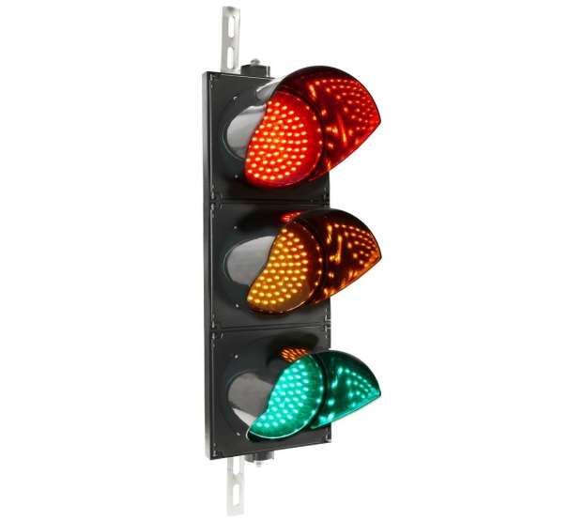
AFL
Why is it important to eat a balanced diet?
Which part of the digestive system do you think is the most important and why?
.

