Slide 1
Phonics
Odd one out

Slide 2
On the next few pages you will see some pictures beginning with one of our sounds. One of the pictures is in the wrong place! Can you spot which one?

Slide 3




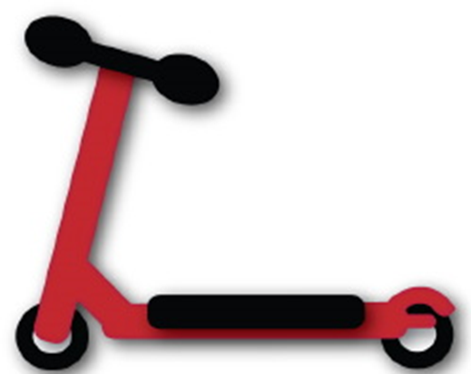


Ss

Slide 4



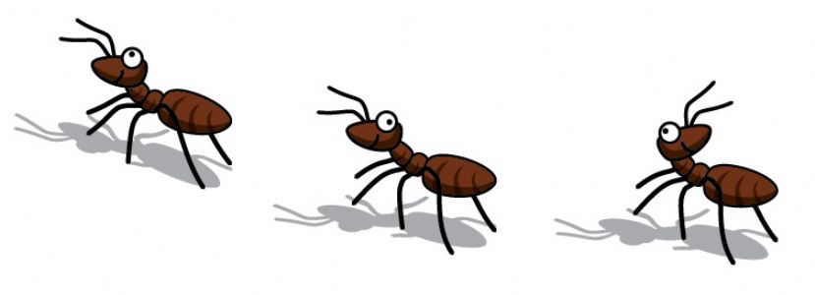


Aa

Slide 5



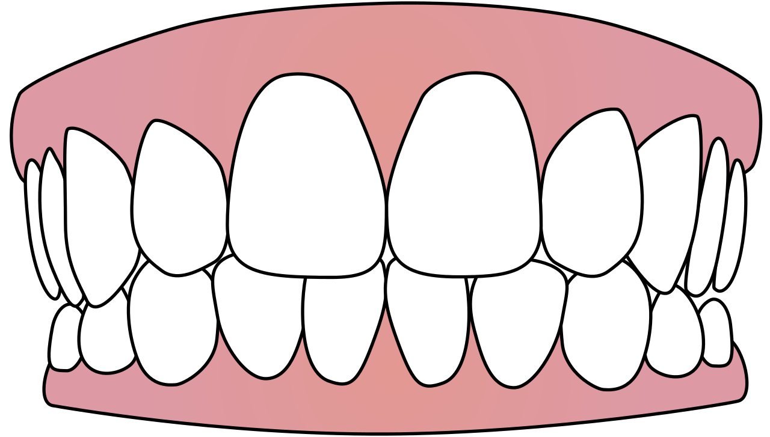
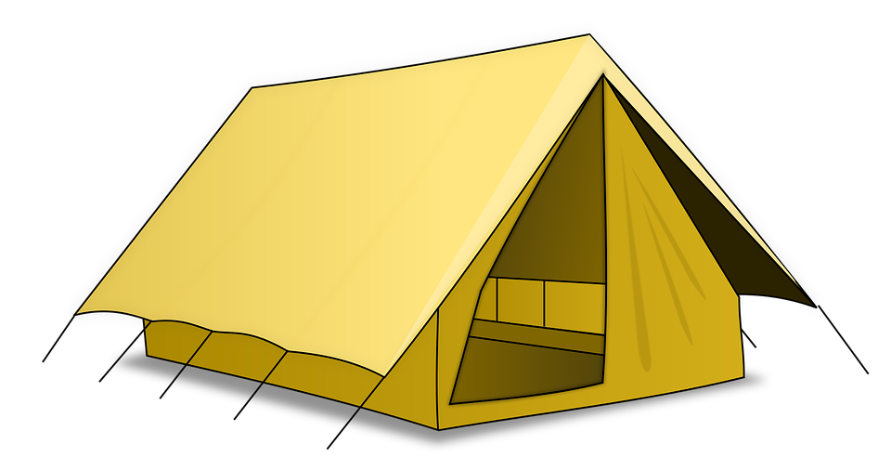


Tt

Slide 6


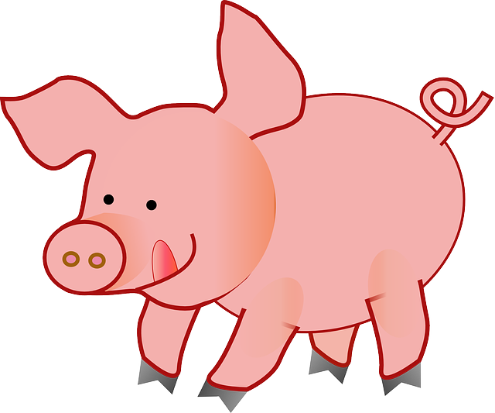




Pp

Slide 7



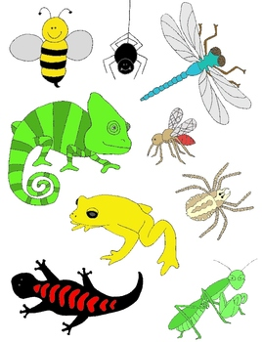

Ii

Slide 8
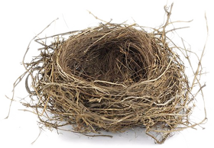

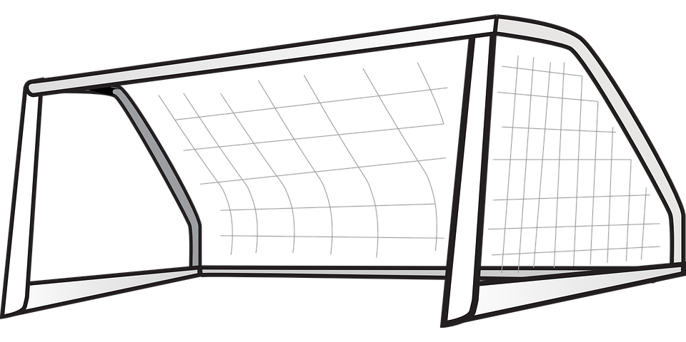

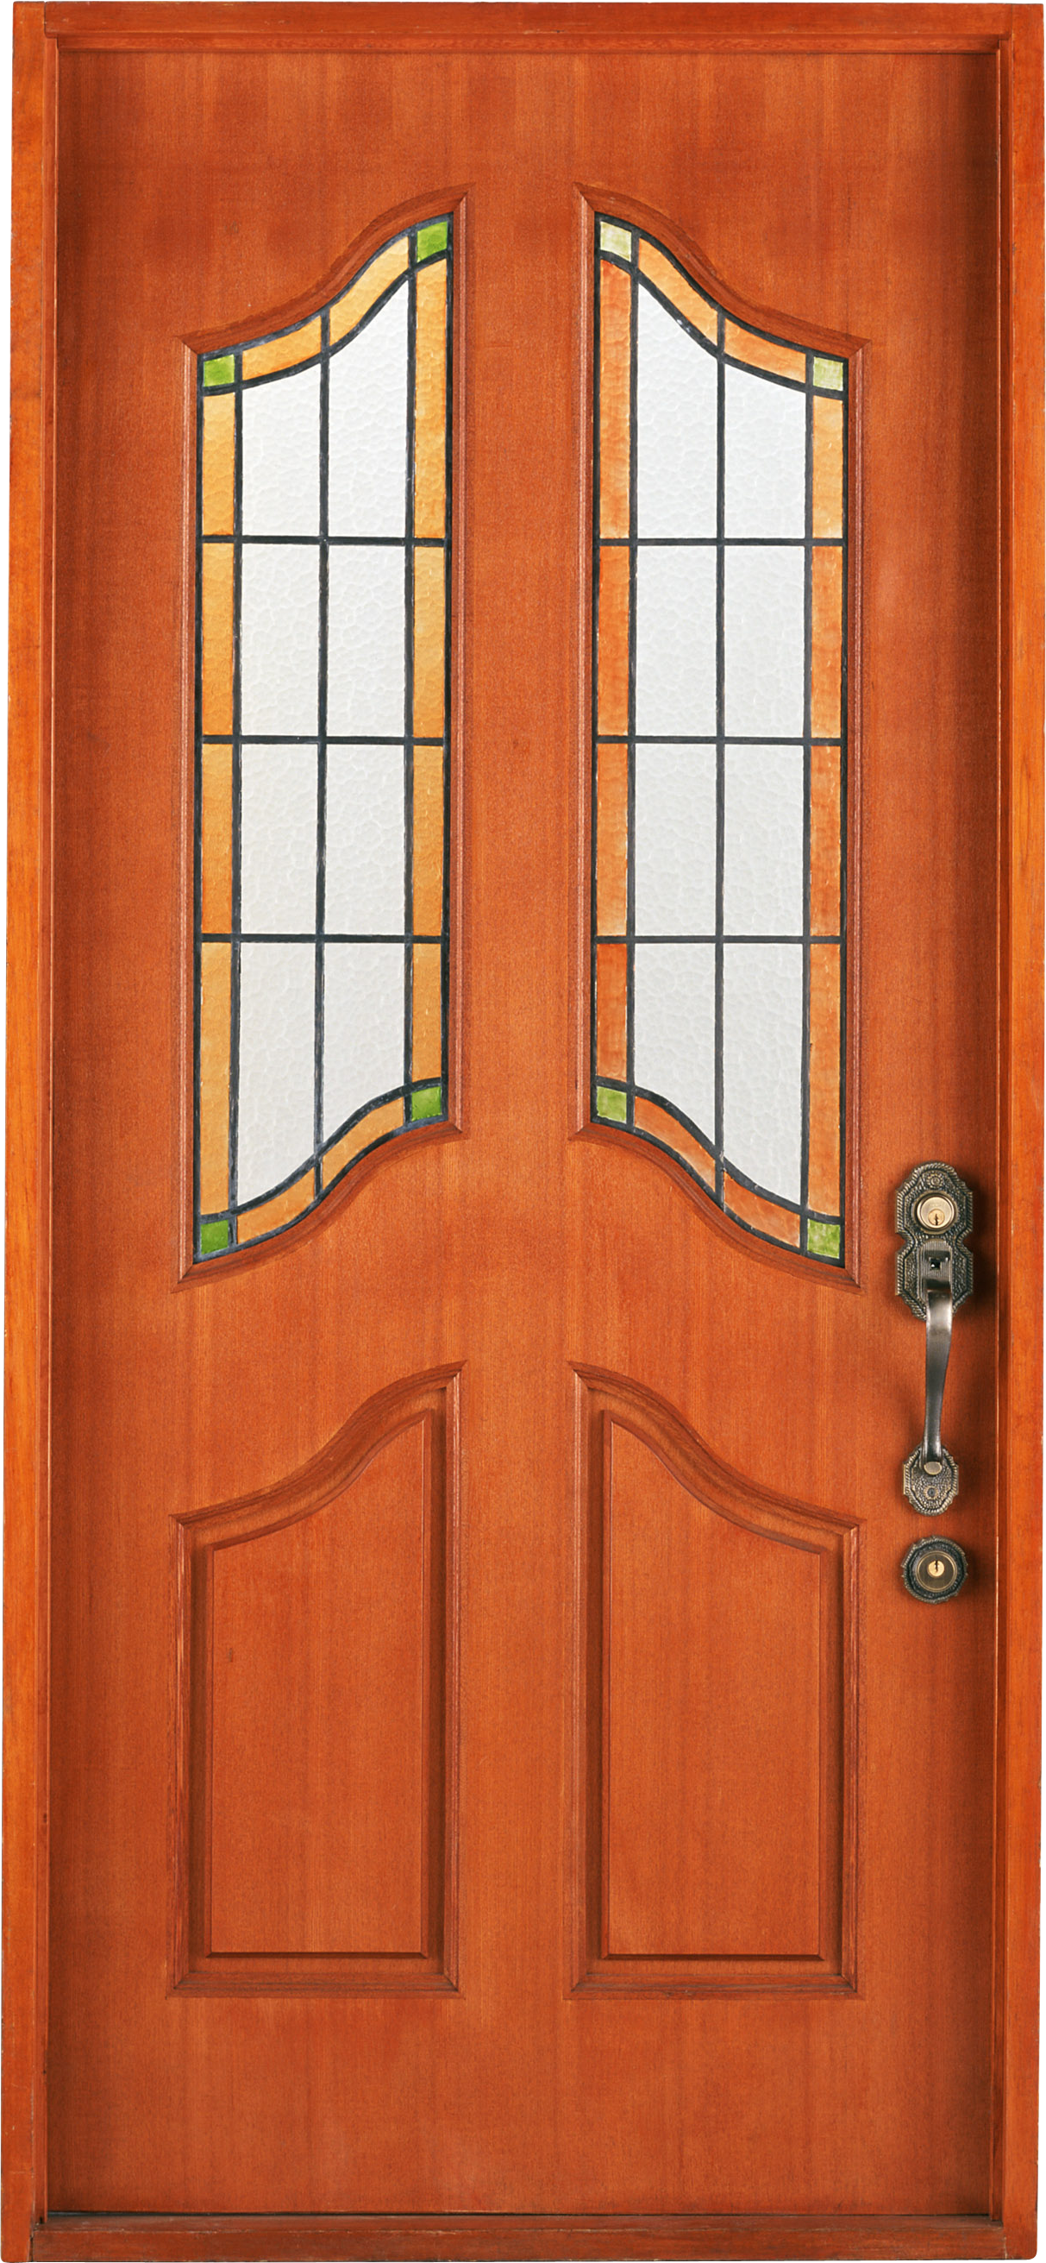


Nn

Slide 9
Extra challenge
As an extra challenge we’d like you to have a try at writing the different letters…

